Slide 1
Climate Crisis
Discussion Session

Slide 2
Session Overview
Setting the scene
What can we do?
Climate Scorecard
Putting in place an environmental policy
Funding
Discussion Questions

Slide 3
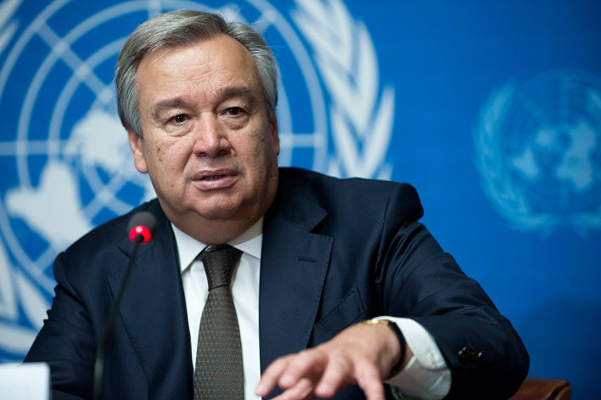
Notes:
Antonio Guterres- Today’s IPCC Working Group 1 report is a code red for humanity. The alarm bells are deafening, and the evidence is irrefutable: greenhouse‑gas emissions from fossil-fuel burning and deforestation are choking our planet and putting billions of people at immediate risk. Global heating is affecting every region on Earth, with many of the changes becoming irreversible. We are already at 1.2°C and rising. Warming has accelerated in recent decades. Every fraction of a degree counts.

Slide 4
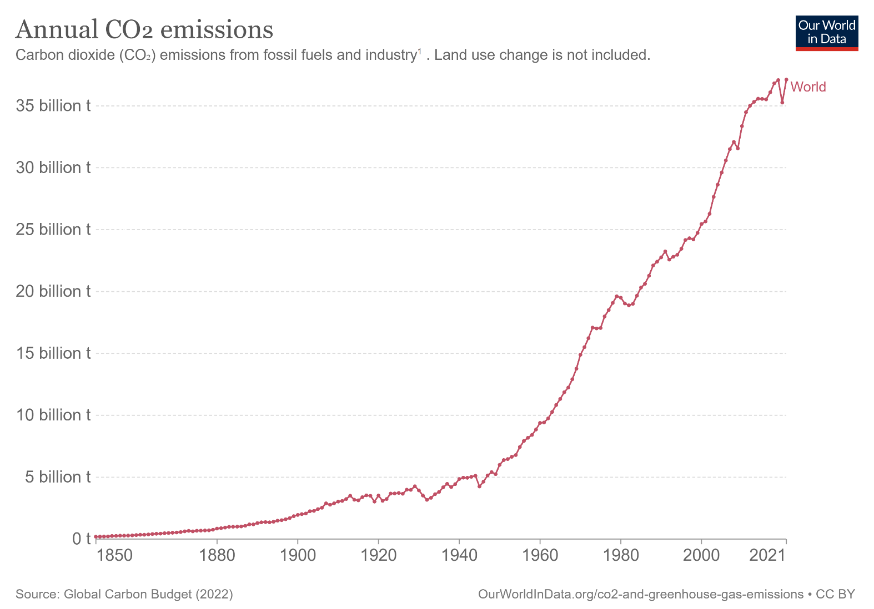
Notes:
Annual C02 emissions have gone from nearly nothing in 1850 to around 37 billion tonnes today

Slide 5
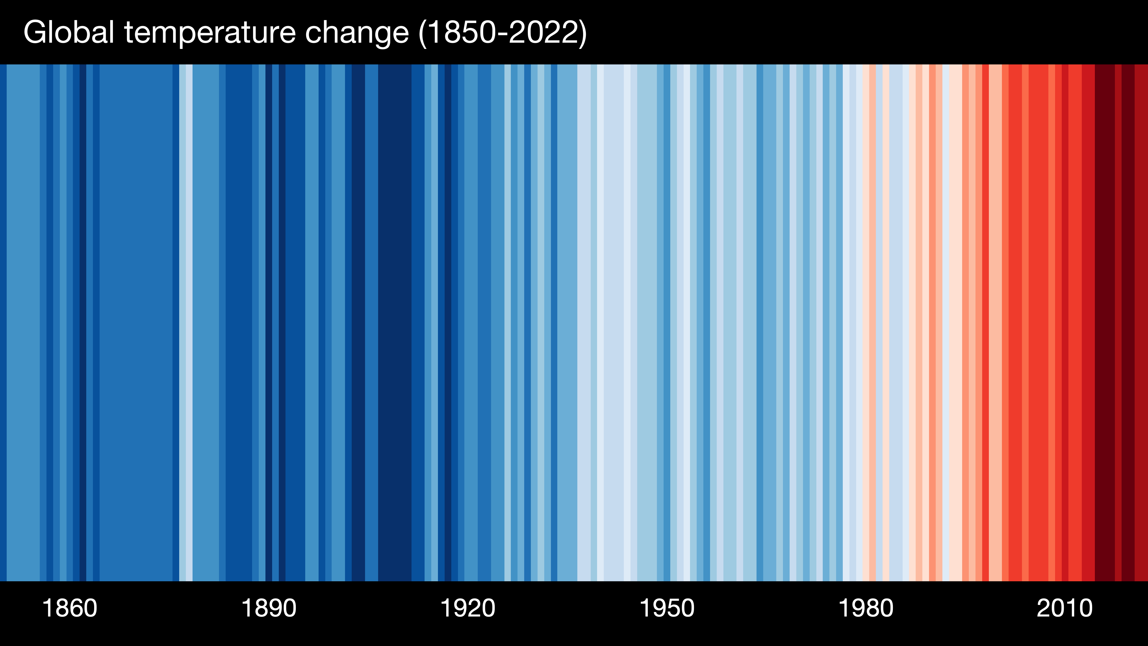
Notes:
2011 to 2020 was around 1.1C warmer than 1850 to 1900
Climate Stripes- https://showyourstripes.info

Slide 6
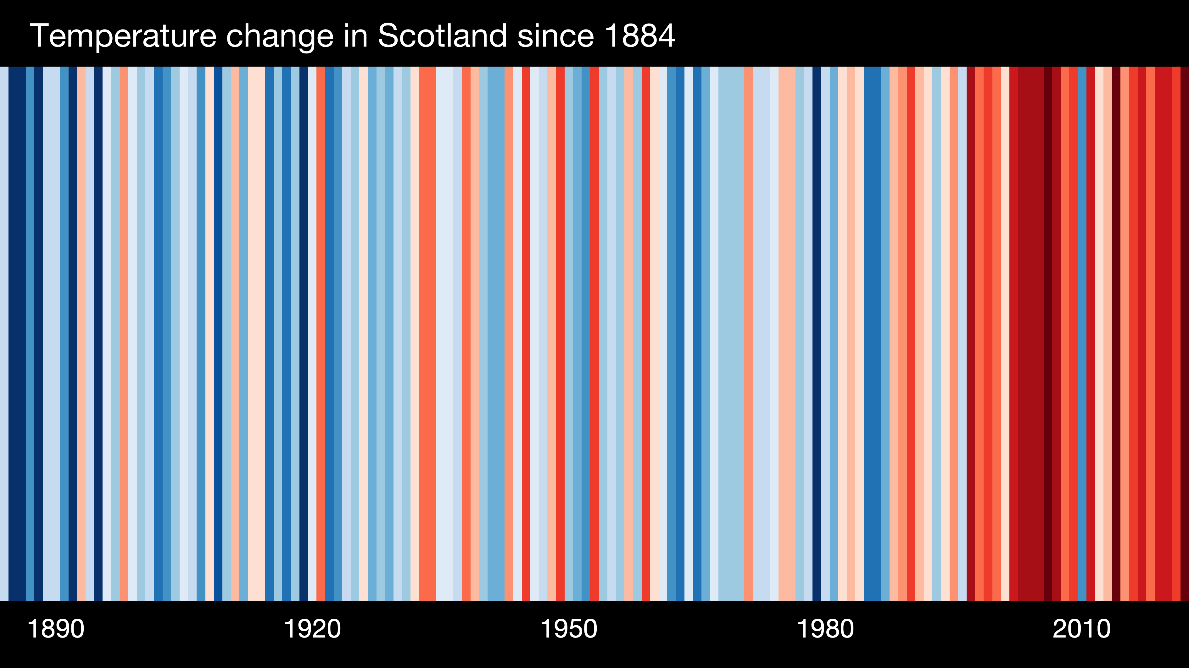

Slide 7
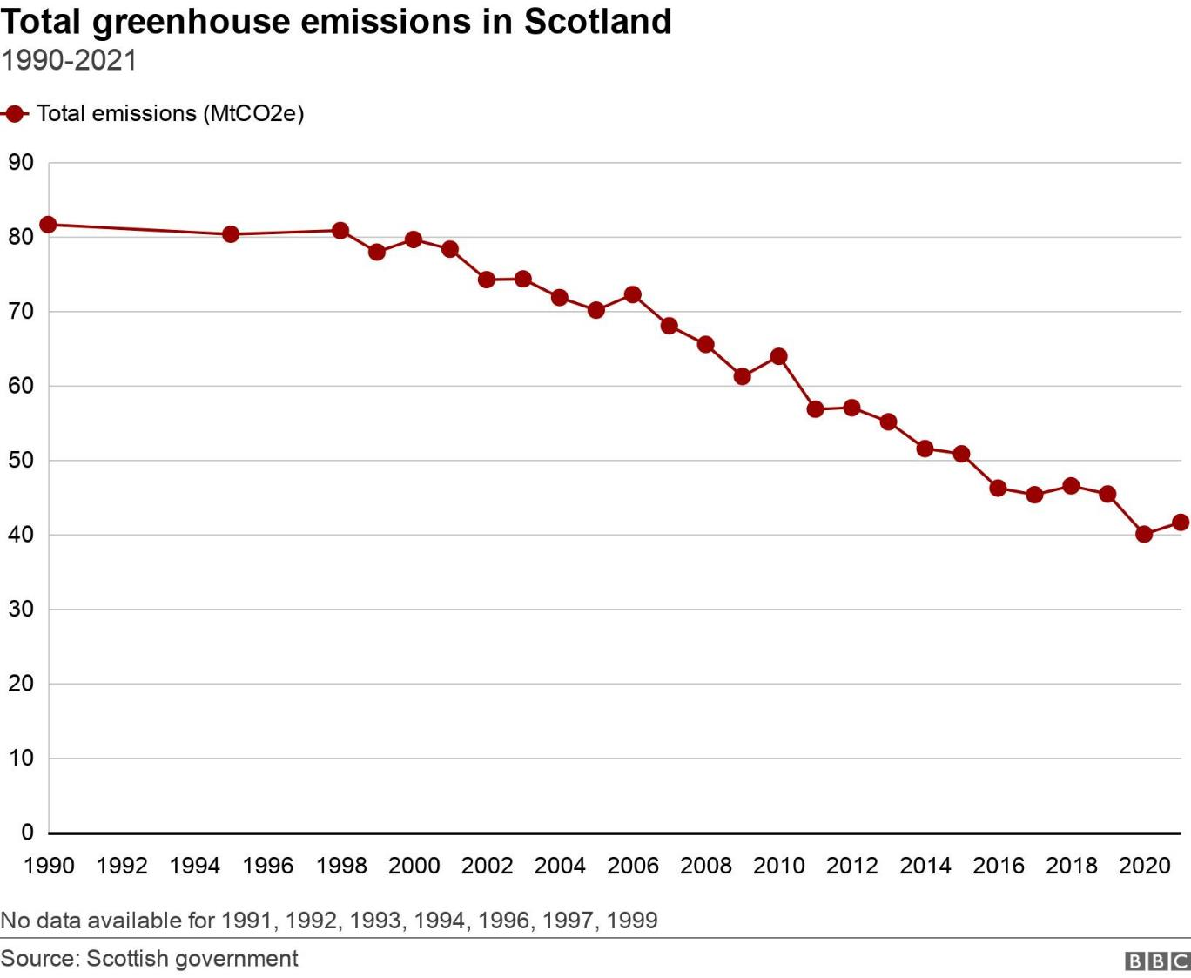
Notes:
Scotland reduced it’s greenhouse gas emissions by 49% between 1990 and 2021
Scottish Greenhouse Gas Statistics 2021
But per person average is still much high than in most parts of the globe and still have a long way to go to meet Net Zero commitments

Slide 8
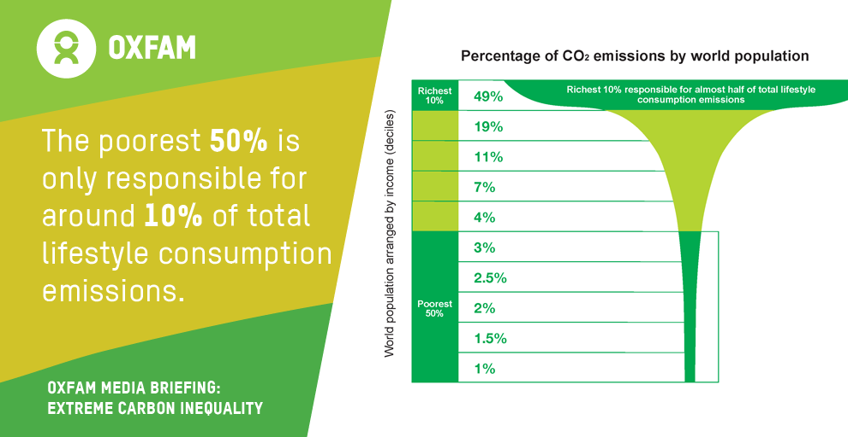
Notes:
Emissions are closely tied to income
But it likely the poorest and most vulnerable who are most affected.

Slide 9
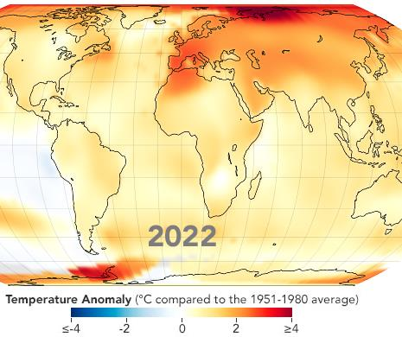
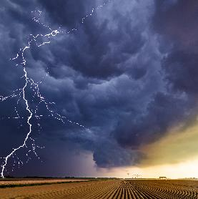
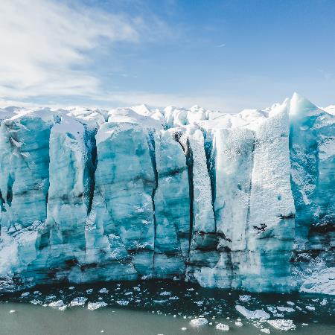
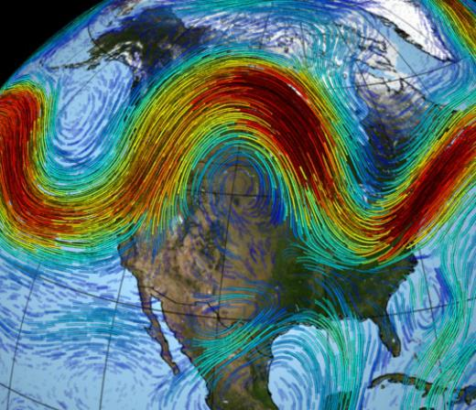
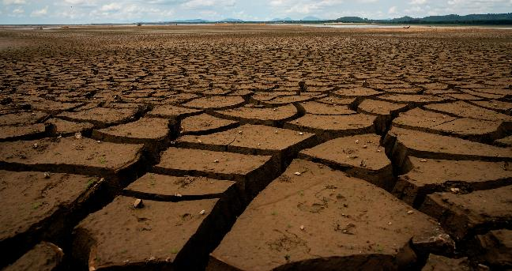
Global Effects on the Climate System include…
Effects of climate change - Met Office
Notes:
Hotter land, air & oceans
Melting ice & rising sea levels
Changes in atmosphere & ocean currents
Changes to the hydrological cycle- droughts and flooding
More extreme weather

Slide 10
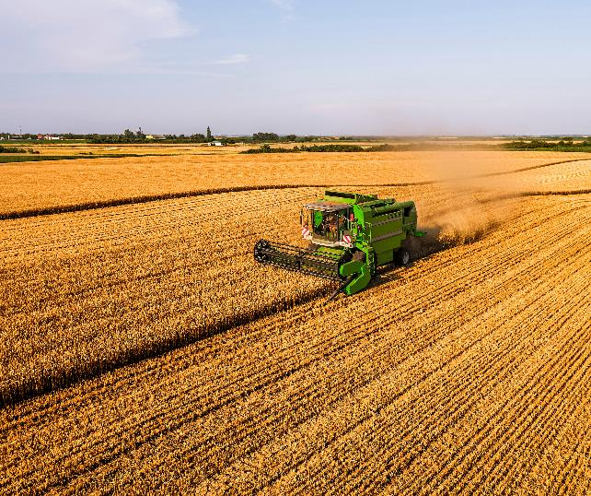
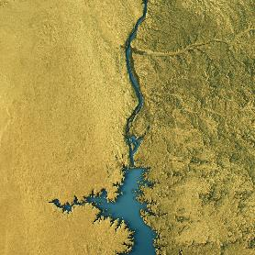
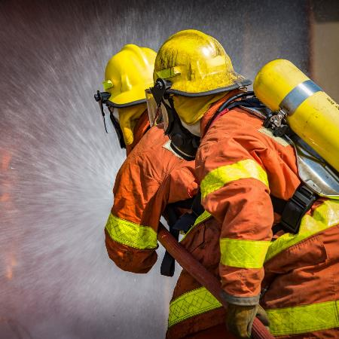
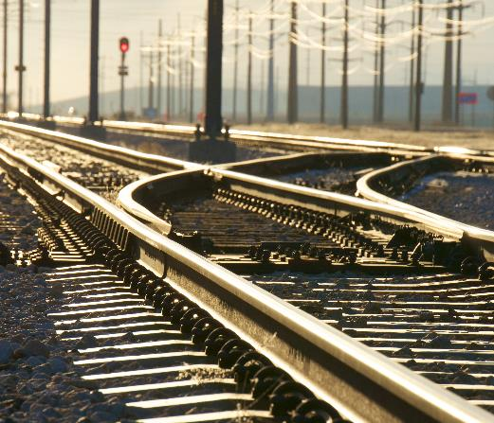
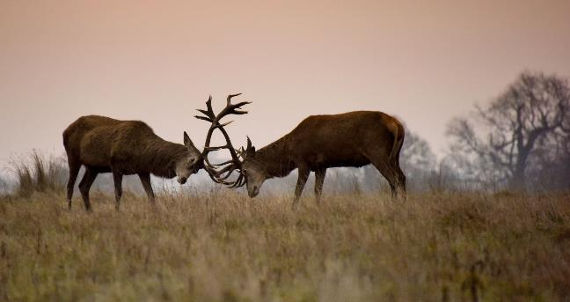
Impacts of this include…
Effects of climate change - Met Office
Notes:
Risk to water supplies
Food insecurity
Damage to infrastructure
Wild fires
Heat stress
Loss of biodiversity
Conflict & migration

Slide 11
Effects on UK Climate
The Met Office Projects…
Warmer & Wetter Winters
Hotter & Dryer Summers
Heavy Rain more likely
Increase in Heatwaves
Possible increase in storms
Effects of climate change - Met Office
Notes:
By 2050, heatwaves like that seen in 2018 are expected to happen every other year.
In 50 years' time, by 2070 we project:
Winter will be between 1 and 4.5°C warmer and up to 30% wetter
Summer will be between 1 and 6°C warmer and up to 60% drier

Slide 12
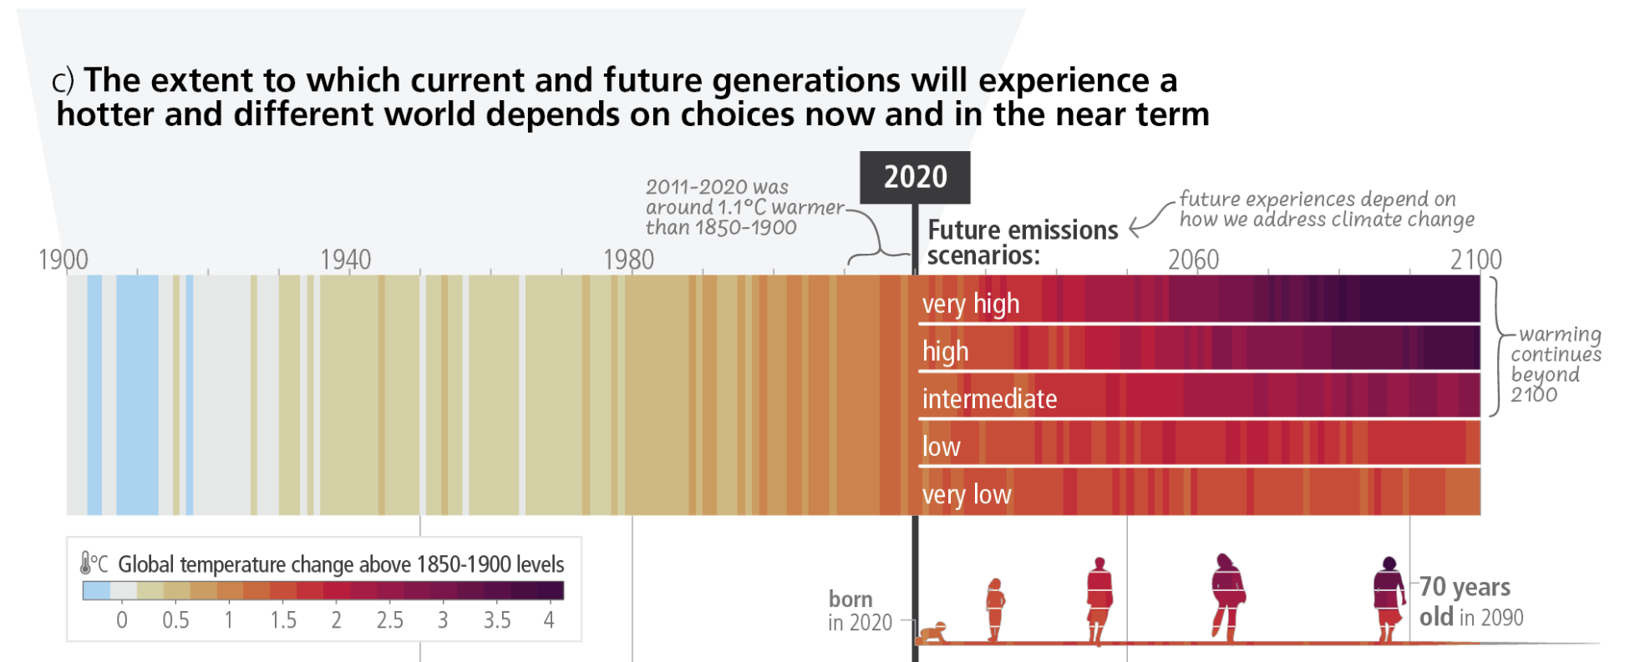

Slide 13
What can we do?
Travel
Policy & Planning
Buildings & Energy
Purchases
Waste
Engage
Food
Nature

Slide 14
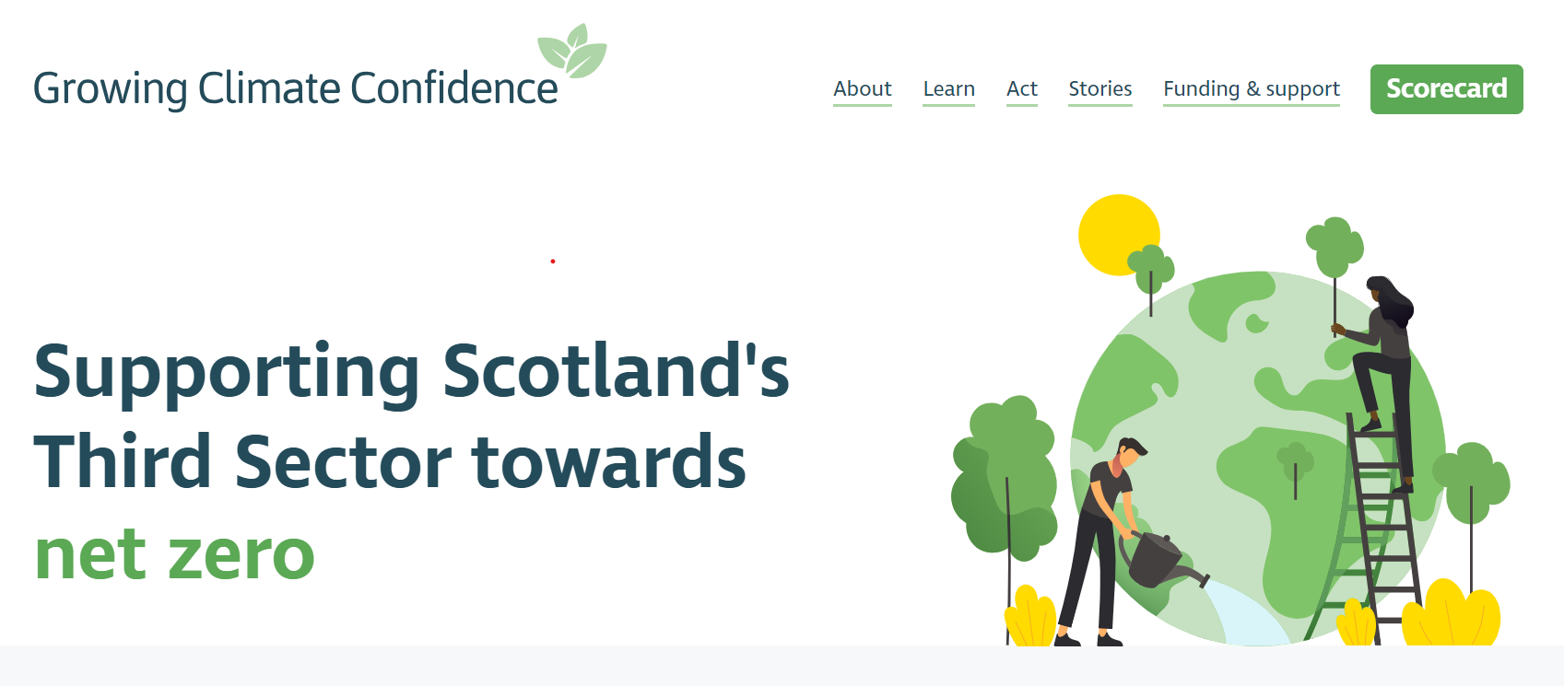

Slide 15
Climate Confidence Scorecard

Slide 16
Writing an Environmental Policy
Vision & Values- why is it important to your organization
It doesn’t need to be overly complicated
Set practical steps
How does it link with any other policies you have?
E.g. risk management, contingency planning
Who is responsible for each action?
Set timescales to review it
For further info & template see: https://climateconfident.scot/act/create-a-policy

Slide 17
Current Funding
Local Energy Scotland - Let’s Do Net Zero Community Buildings- Up to £80,000 towards reducing building energy costs & greenhouse gas emissions.
Local Energy Scotland - CARES Development Support and Funding – Supporting communities with renewable energy technology, shared ownership etc.
The Scottish Government - Climate Engagement Fund- £50,000 to £100,000 to build understanding of the climate emergency across communities in Scotland Next deadline: 1 Sep 2023
For more see Funding Scotland… www.funding.scot

Slide 18
For further info visit:
www.climateconfident.scot

Slide 19
Discussion Questions
1 Are organisations currently doing anything to implement greener initiatives, if so, what?

Slide 20
2 Do organisations feel there are any barriers preventing them from implementing greener initiatives? If so, what are these?

Slide 21
3 How do organisations think EDVA could help them overcome these barriers, or generally support them specifically in relation to the climate crisis?

